Slide 1
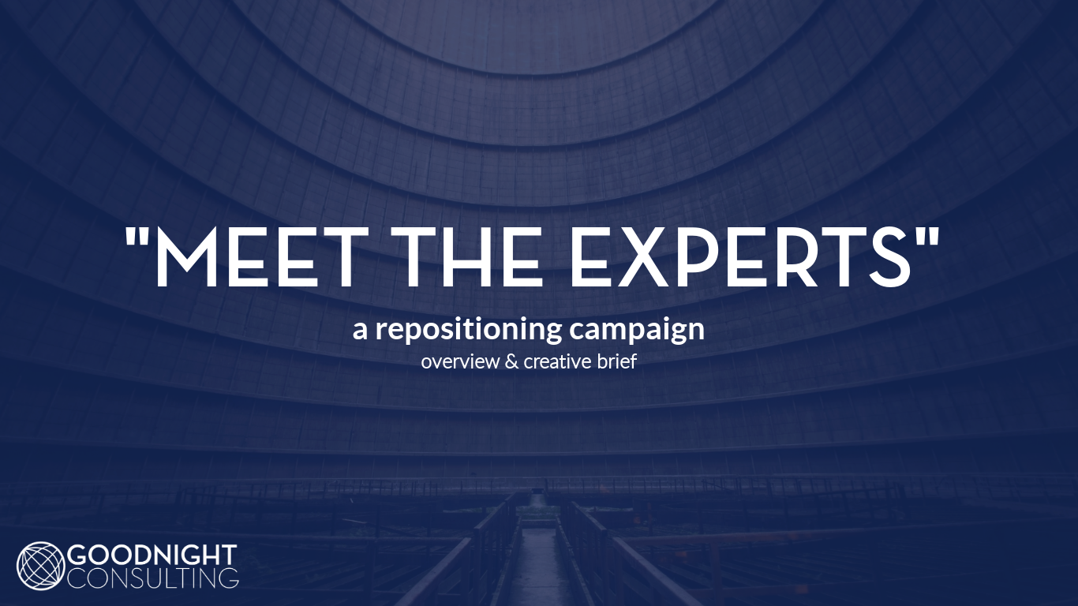
Sam Goodnight
Marketing Director
August 2018

Slide 2

OBJECTIVES
Reposition the Goodnight Consulting brand – demonstrate to our client base that Goodnight Consulting’s capabilities have grown beyond the staffing studies we are known for.

Slide 3
OBJECTIVES
Target power industry decision-makers beyond CNOs, including middle managers and team leaders.
Develop new business using a “people and projects” approach: placing our consultants with aforementioned decisionmakers in order to fill personnel gaps or provide critical solutions (projects).

Slide 4
NEW POSITIONING STATEMENT
“
“
Goodnight Consulting arms electric utility leaders with the Skilled Experts they need to power improvement. Whatever is keeping you up at night, they’ll help you rest easy by bridging gaps in expertise and executing turnkey project solutions.

Slide 5
CORE STRATEGY
Divide the stable of consultants (“Skilled Experts”) into several archetypes (“Classes”) defined by skillset, industry experience, and consulting role.
Each class of Skilled Expert should be unique, identifiable, and should visually communicate their defining characteristics.

Slide 6
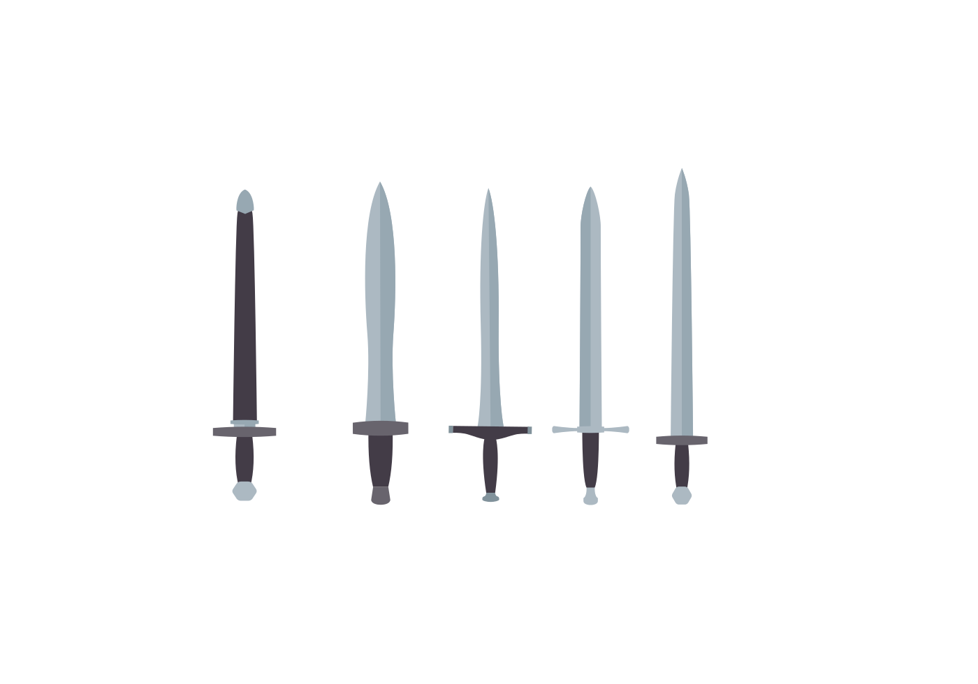




Creative Direction
Each class will be represented by a caricature of a different knight. Opportunities for wordplay with company name.
Knight imagery evokes:
Loyalty
Trust
Service
Guardianship
Professionalism
Skill
Dauntlessness
Scars create distinction between classes; suggests experience, adds to character
Colors, shield icon, and weapons correspond with role and personality of each class.
Tag is reminiscent of power plant ID, implies industry qualifications or credentials.

Slide 7
Skilled Experts
“Putting your problems to bed.”
— THINK —
“I need industry experts with rare skills to resolve the issues that keep me up at night.”
— FEEL —
A desire for security and peace-of-mind arising from the resolution of key concerns
— DO —
Schedule a call with Goodnight Consulting to discuss how I can leverage the capabilities of their Skilled Experts
This is the generic Skilled Expert; does not represent any particular class, but rather the Skilled Experts as a collective.

Slide 8






THE EXPERTS

Slide 9
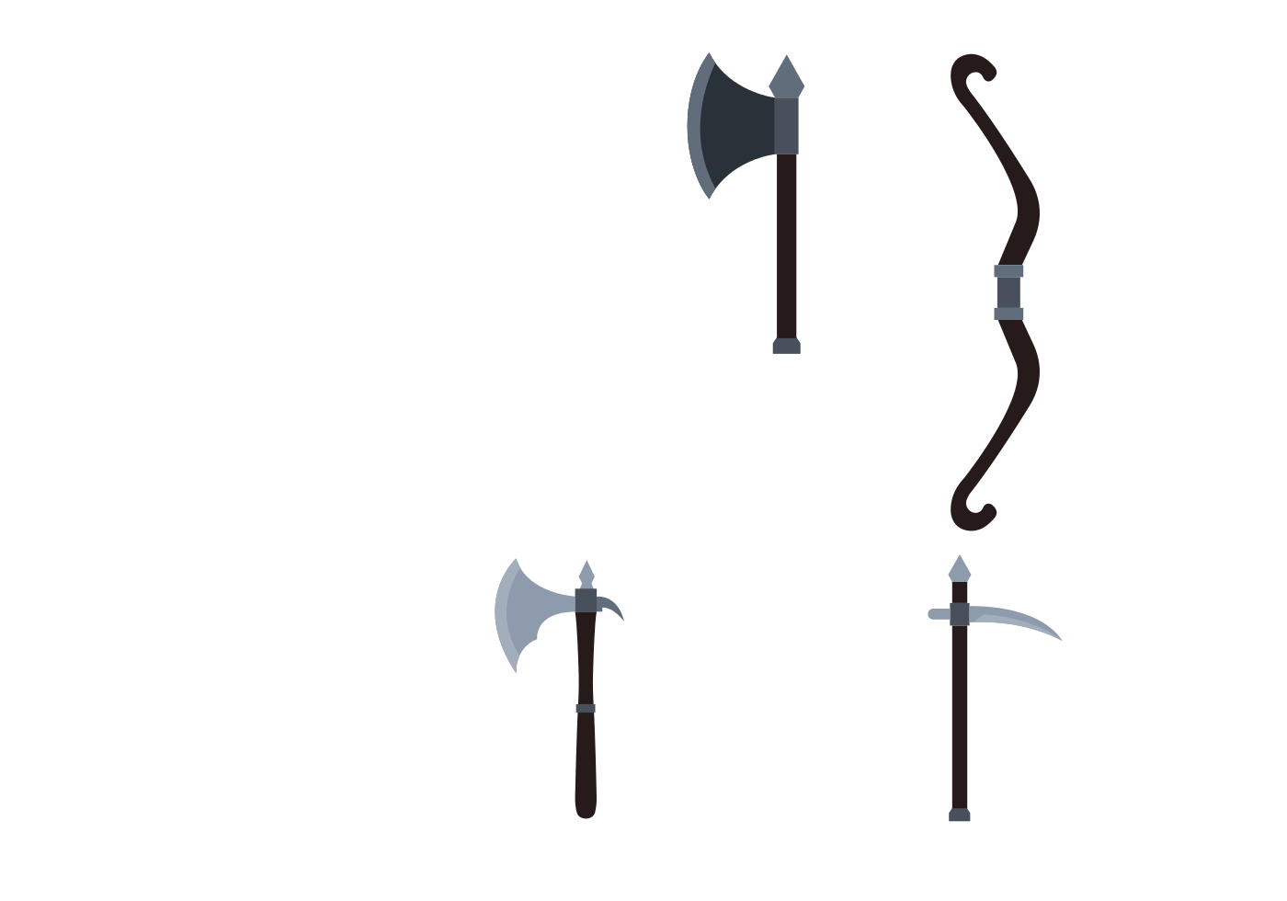



Classes
THE UTILITY KNIFE
“Been there. Done that.”
“A seasoned veteran with a storied career and an industry-spanning résumé. As your personal fixer, the Utility Knife helps you get to the root of any problem - including the ones you didn't even know you had.”

Slide 10
The Utility Knife
— ROLE —
Versatile fixer, organizational assessor, senior adviser
— TARGET —
Senior decision-makers; site VPs, plant managers, executives, etc.
— BENEFIT —
“ The Utility Knife class can help me identify and tackle a vast range of root-problems in my organization.”
— RARE SKILLS —
Diversity of Experience | Technical Acumen | Leadership Expertise | Results-Oriented

Slide 11


Classes
THE PROFESSIONAL
“Give me an order.”
“A master implementer with versatile a skillset. This class focuses on project management and execution; when you need someone to roll up their sleeves and cut through your growing backlog, call the Professional.”

Slide 12
The Professional
— ROLE —
Project planning, execution, & management
— TARGET —
Decision-makers with significant task buildup or project loads
— BENEFIT —
“ The Professional class takes the burden of projects off my shoulders and turns planning into action. ”
— RARE SKILLS —
Project Expertise | Strategic Acuity | Implementation | Project Management

Slide 13
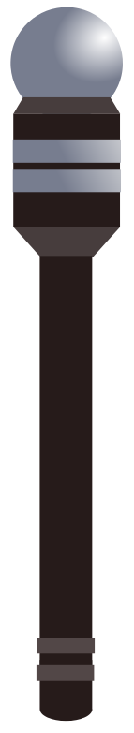



Classes
THE ADVISOR
“Lighting the way.”
“A soft-skills SME and workforce mentor. Equipped with years of focused experience and senior management credentials, the Advisor acts as your go-to counselor for areas like knowledge management or human performance.”

Slide 14
The Advisor
— ROLE —
Soft-skills SME, program designer, workforce optimizer
— TARGET —
Program managers in areas like HR, knowledge management
— BENEFIT —
“ Advisors can help me with qualitative challenges & human performance.”
— RARE SKILLS —
Qualitative Mindset | Subject-Matter Mastery | Optimization Focus | Workforce Engagement

Slide 15
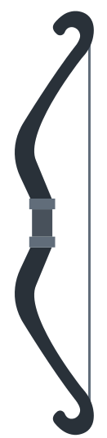


Classes
THE SPECIALIST
“Show me where it hurts.”
“A subject-matter expert in a technical field, complete with all the necessary certifications. From inspection services to single-point vulnerability, there's a Specialist to cure any of hard-skill pain point.”

Slide 16
The Specialist
— ROLE —
Technical SME, surgical problem-solving, process improvement
— TARGET —
Technical managers with skills gaps in their organization
— BENEFIT —
“ The Specialist class can easily drop into and out of my organization to fill niche skills gap – and improve my processes as the same time.”
— RARE SKILLS —
Technical Acumen | Process Mastery | SME Certifications

Slide 17



Classes
THE EXECUTIVE
“I ran companies like yours.”
“A power industry maven and former senior executive at a major utility. When it comes to critical initiatives, the Executive is there to provide you with boardroom-level insight.”

Slide 18
The Executive
— ROLE —
Chief adviser, oversight boards, executive coach
— TARGET —
Top-level decision-makers; new to their position, out of their depth
— BENEFIT —
“ Members of the Executive class understand what keeps me up at night, and show me how to put those problems to rest. ”
— RARE SKILLS —
Industry Mastership | Keystone Strategy | Leadership | Mentoring

Slide 19
CAMPAIGN OVERVIEW
Each class will receive a short video (1-2 minute duration) spotlighting their unique traits, rare skills, applications, and benefits. These will be disseminated via multiple channels, including a blog post series.
Our current Resource List (stable of consultants) will be updated to reflect the new class divisions.
A new page will be added to the website to showcase the different classes and highlight our expanded capabilities.
Existing marketing materials will be redesigned to focus on the “people & projects” aspect of our new business model. Future marketing content will likewise center on these topics:
Business cards
Print advertisements
Direct sales approach & email marketing
Rack cards & other conference materials
LinkedIn PointDrives
Upcoming 2018 US Nuclear Staffing Newsletter

Slide 20


